Slide 1

Adam’s Theory APP
BIBA-3A D0433923 Randy Chiang
GroupQ

Slide 2
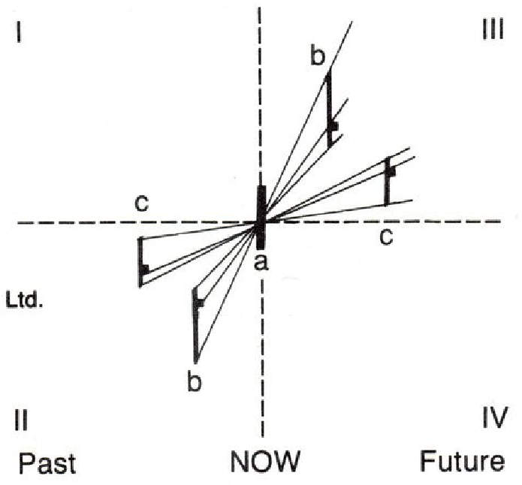
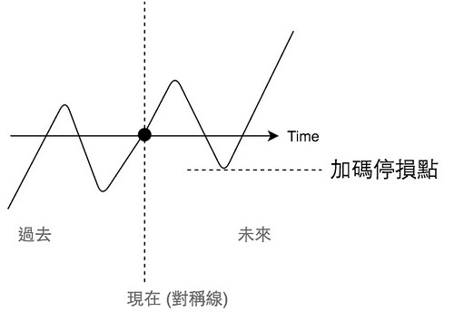
Concept

Slide 3
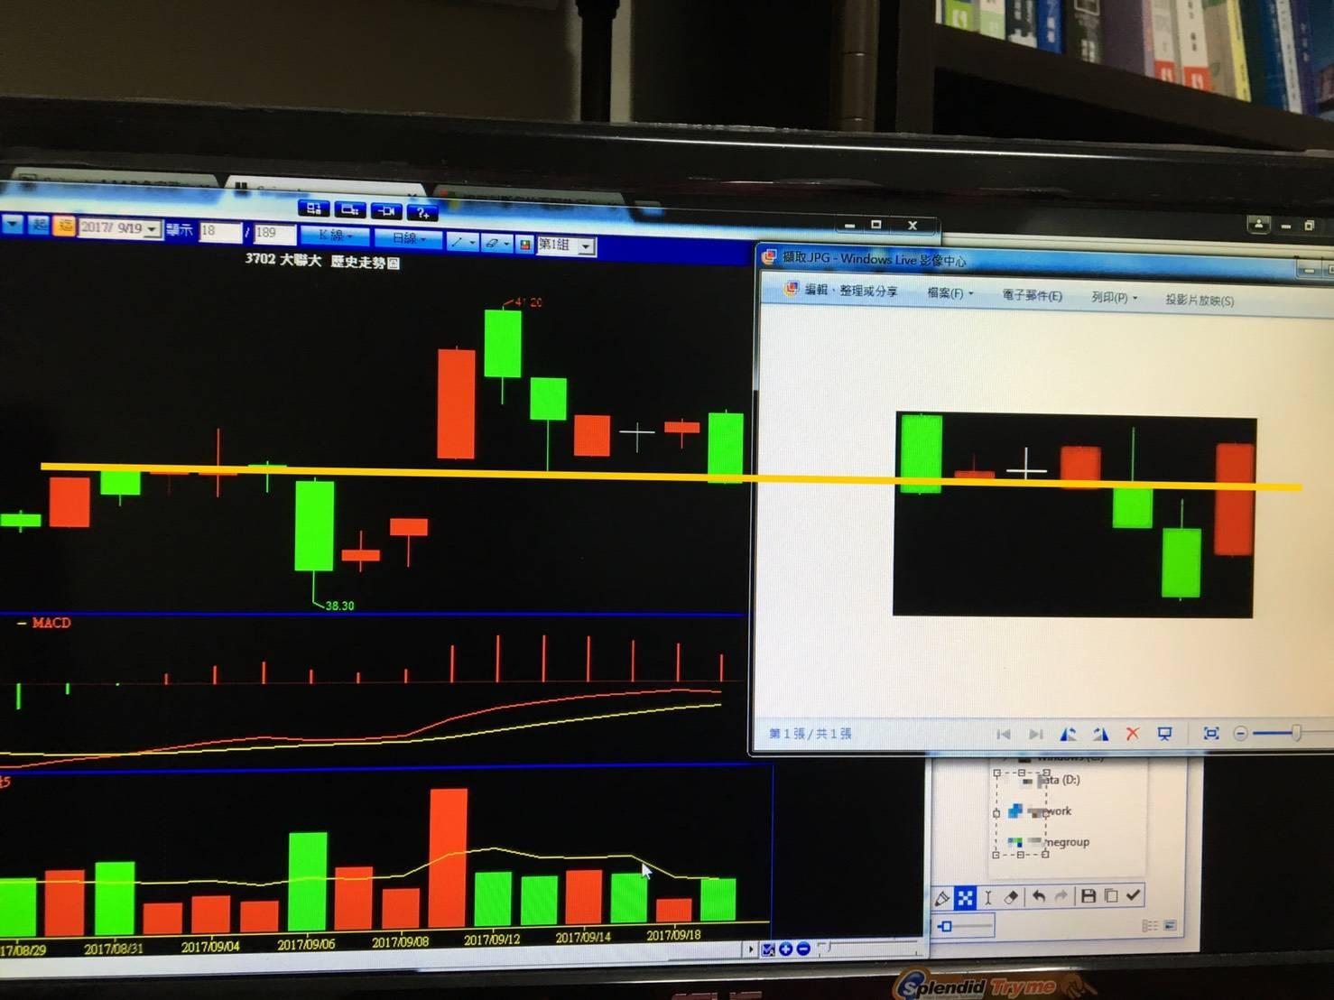
Graphics

Slide 4
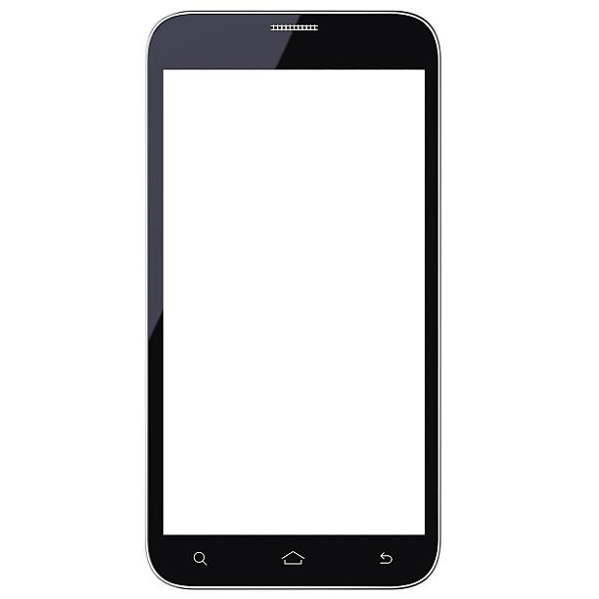
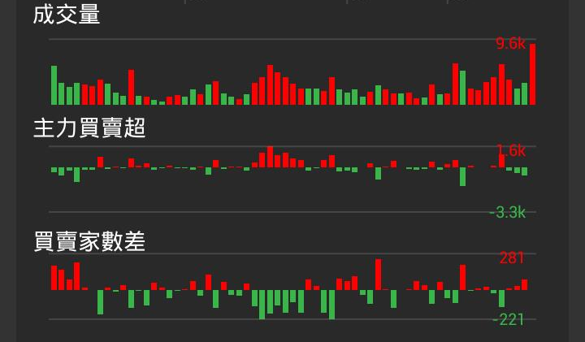
IDEA
If we don’t need to draw graph by our-self?

Slide 5
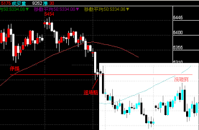
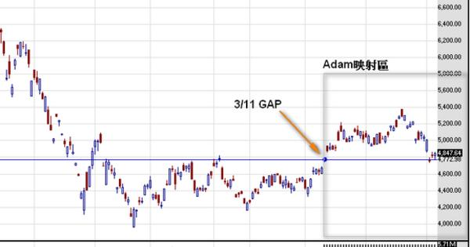
Requirement
App Inventor
R
Python
Machine Learning
SQL

Slide 6
THE END

